Slide 1
Analyzing Socioeconomic Effects on Suicide Rates
Phuc Lu, Nathan Ho, Calder Glass,
Aayushi Avabrath, Anna Cha
Notes:
Hello Judges! We’re so excited to bring to you our presentation for the 2025 data orbit datathon. Name and working with

Slide 2
Background
Skills
Interaction of socioeconomic events and mental health.
Data found on Kaggle (Suicide Rates & Socioeconomic Factors (1990 - 22))
Data Cleaning, Variable Selection, Poisson Response, Data Analysis, Data Visualization, Time Series Analysis
Notes:
Overview:
For a bit of background, we were interested in seeing the interaction of socioeconomic events or changes with mental health
We found a dataset titled Suicide Rates and Socioeconomic Factors from 1990 to 2022 on Kaggle.
Skills
Some of the skills we incorporated into our data visualization project include: (list them)

Slide 3
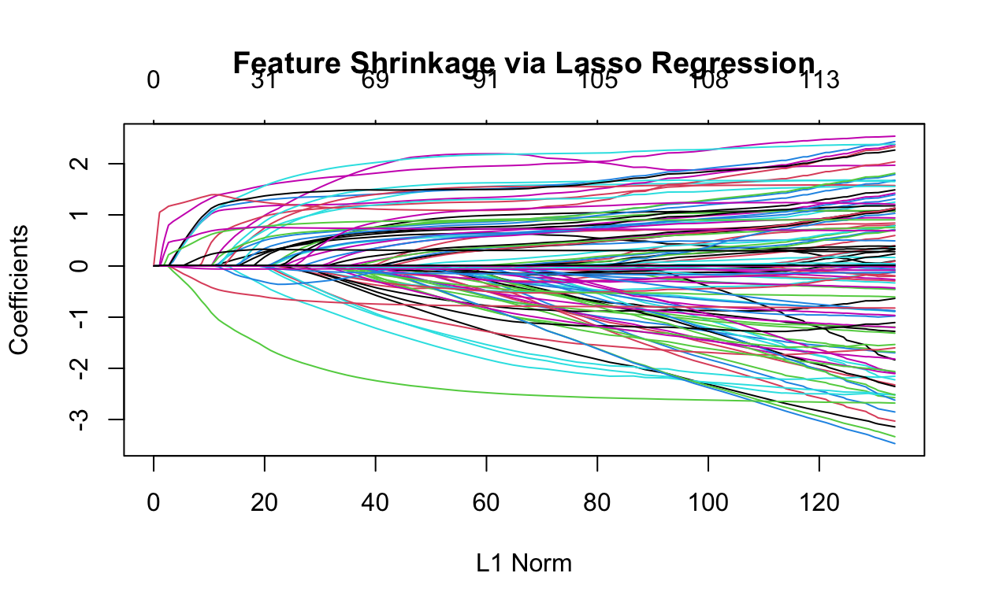
Data Cleaning & Variable Significance
The dataset contained many redundant variables and duplicate observations (23,326 obs and 14 variables.)
Cleaning duplicate observations
Variable Selection:
Stepwise Variable Selection with AIC criterion (Not effective)
Lasso Regression
cross validated λ = 0.06.
Chi-Square Test at α = 0.05
Country’s Wealth Status | Inflation Rate | Cause Death Per Capita | Sex | Age
Suicide Rate Per 100,000 People | Employment to Population Ratio | Current Year | Country’s Population
Notes:
Calder: Talk about an example of duplicate observations (people from same age range, country, sex but with different suicide counts, challenge of combining rows and the right metrics to use when combining said rows)
We used suicide counts as our response variables
9 significant variables.

Slide 4
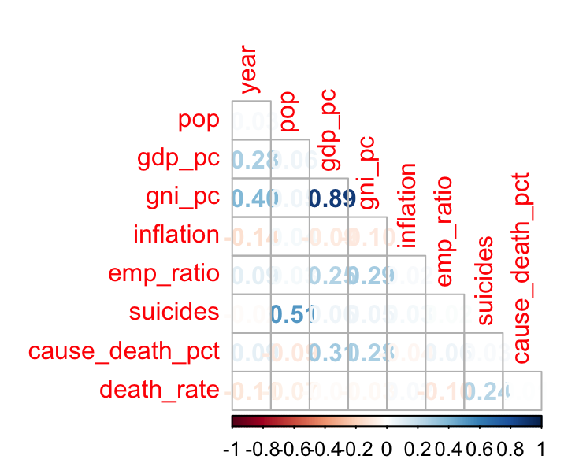
Correlations
In terms of numerical variables,
GDP per capita and GNI per capita
For categorical variables, we tried used common sense to remove the repeated variables.
Ex:
GDP and GDP per capita,
country code and country name
Notes:
Looking at the correlation mat for Numeric Data we have things such as
GDP per capita - domestic production
GNI per capita - Imports and exports
Which makes sense because they are both economic data.
Categorical remove variables that are redundant, such as country code and country name.

Slide 5
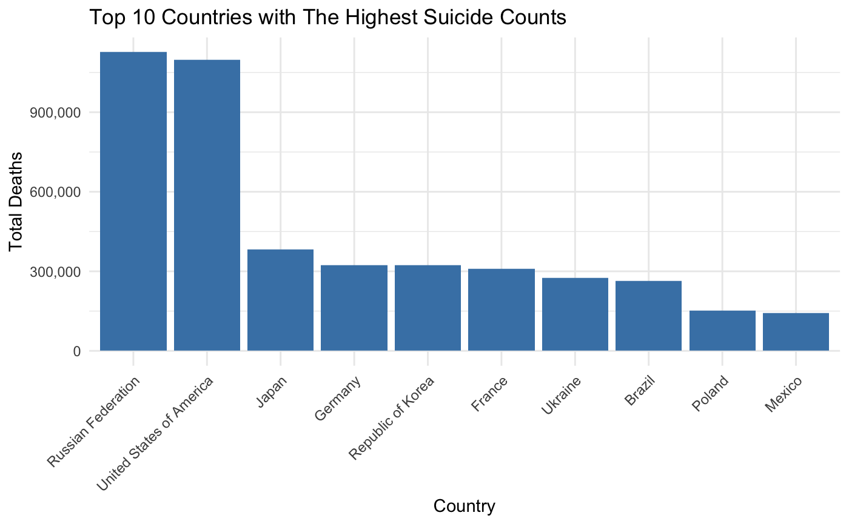
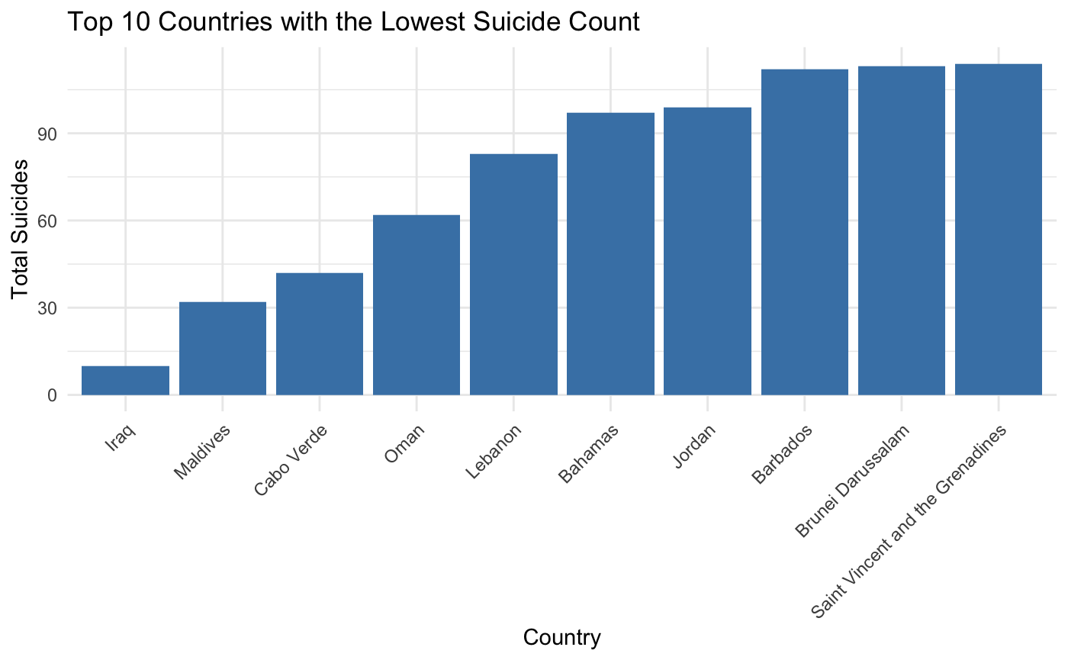
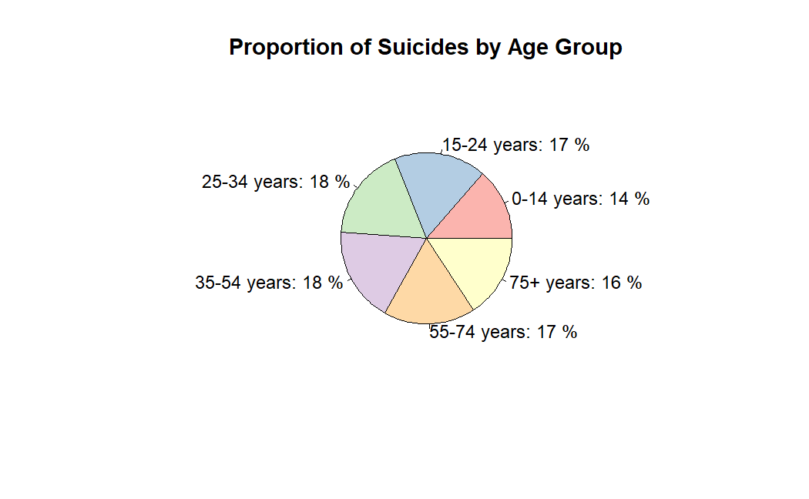
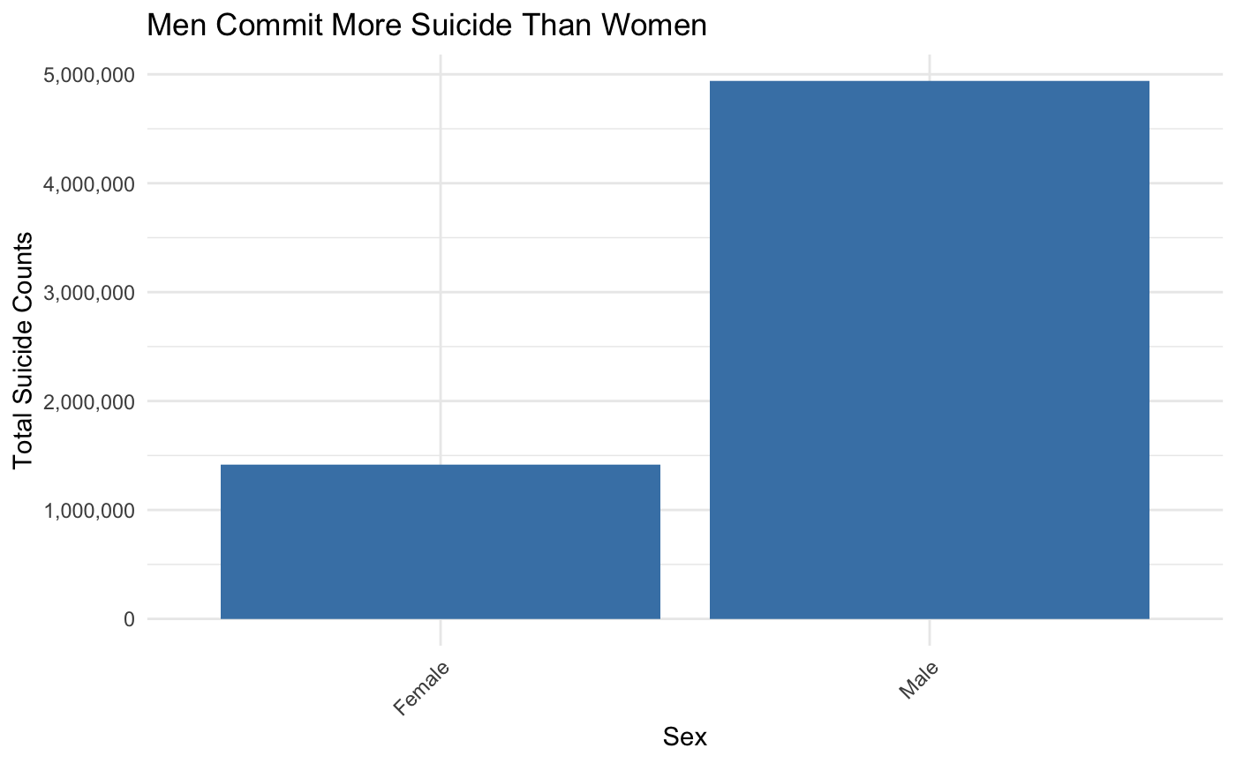
Summary Statistics
Notes:
Calder: Note how the top two countries for top left plot are Russia and the US, how proportion of suicides is fairly equal for each age group, and how men commit most of the suicides despite the proportion of men vs women being equal in the dataset

Slide 6
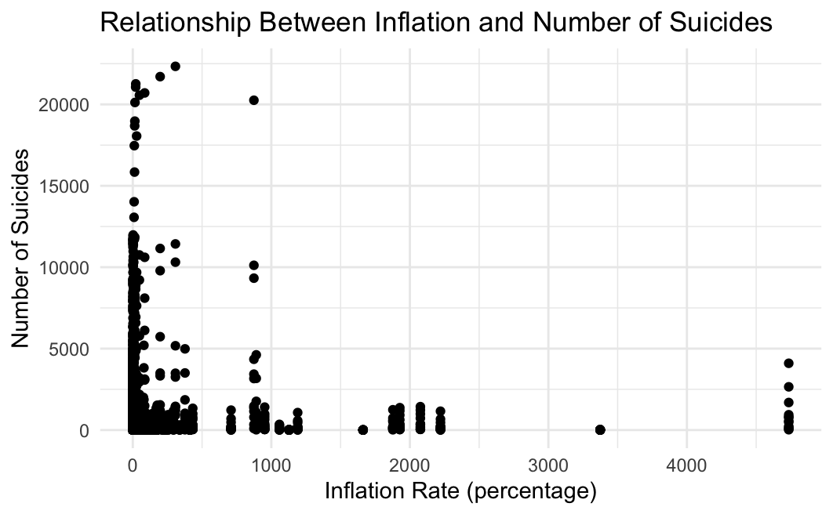
Did you know?
Hyperinflation Ukraine in 1993
Uncontrolled monetary regime
Large debt to Russia for goods delivered through state trade.
Inflation rate in 1993
Google: 10,155%
Data : 4,734.914%
Notes:
This graph shows the number of suicides following hyperinflation in Ukraine in 1993, represented by the dots on the very right. Due to an uncontrolled monetary regime and a large debt accumulated, we found that Ukraine had high suicide rates in 1993.
The inflation rate in 1993 captured through our data is 4,734.914% while the rate provided on Google is 10,155% indicating that different datasets were used.

Slide 7

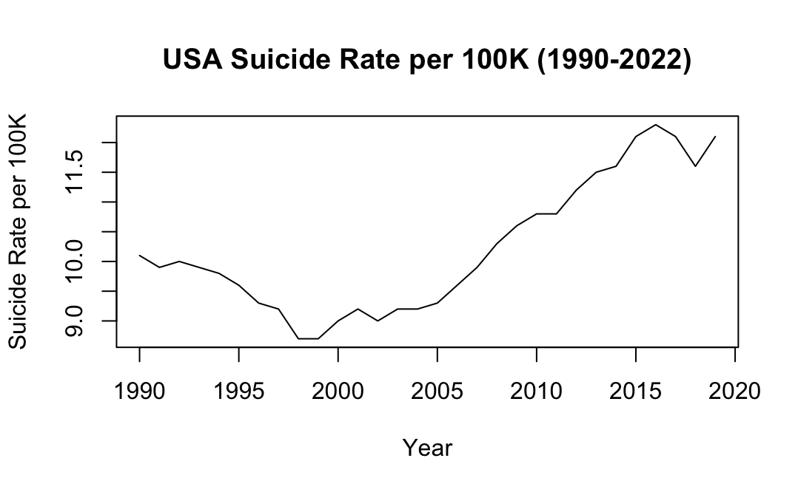
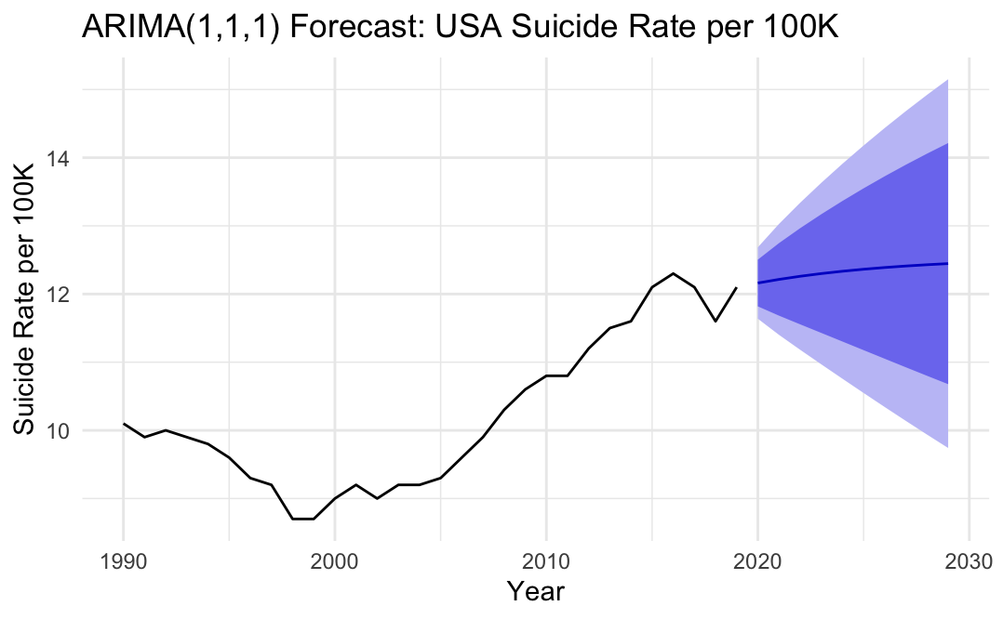
Time Series Analysis
Time Series modeling of the United States suicide rate per 100k from 1990-2022.
1990-2000 Dot Com Boom, Stock Market Growth
2000-2007 still remained low by continued residuals from dot com boom
2008 Financial Crisis, increase in suicide rates from Opioid Epidemic, Rise of Social Media and Cyber-bullying
2018-2020 Slight dip recovering economy
2020 onward increase from COVID-19, post-pandemic society
ARIMA model forecast, differenced for stationarity suggests a moderate upward trend in suicide rates
Uncertainty over time, widened due to potential external influences like economic conditions and policy changes.
Notes:
Looking at time series data of the United States from 1990-2022, we see a few important things. From 1990-2000 we see a steady decline in suicide rates due to the rise of the internet, and the dot com boom leading to stock market growth. Increase in suicide rates from 2008-2018 we have the 2008 financial crisis, opioid epidemic, rise of social media/cyber-bullying. 2020 onward COVID-19 and post pandemic society. To explore future trends, we visualized a forecast using the ARIMA models, applying differencing suggesting a moderate upward trend in suicide rates with increasing uncertainity over time. This can widen due to potential external influences like economic conditions or policy changes.

Slide 8
Resources at UCSB
Mental Health
Health and Wellness
Counseling and Psychological Services (CAPS): In-person talk therapy sessions
Professional consultation
Activities, and events for students and faculty
Sense of community, belonging, and compassion.
“Behind all these figures, there are individuals who have left behind a family or community devastated by their loss. By taking action together, we can reduce suicide.”
Notes:
Mental Health:
We want to highlight some of the ways UCSB gives resources to promote student well-being. For mental health, they provide counseling and psychological services also known as CAPS for in-person therapy sessions and professional consultations.
Health and Wellness:
The Health and Wellness society at UCSB organizes activities and events for students and faculty alike. They promote a sense of community and navigate students towards academic success and a fulfilling life.
Behind all our data, there are individuals who have left behind a family or community. We can reduce suicide by taking action together.

